Slide 1
4.1 Types of software and interrupts
Describe the difference between system software and application software and provide examples of each
Describe the role and basic functions of an operating system
System software provides the services that the computer requires, including operating system and utility software
Application software provides the services that the user requires
– Managing files
– Handling interrupts
– Providing an interface
– Managing peripherals and drivers
– Managing memory
– Managing multitasking
– Providing a platform for running applications
– Providing system security
– Managing user accounts
Understand how hardware, firmware and an operating system are required to run applications software
Applications are run on the operating system
The operating system is run on the firmware
The bootloader (firmware) is run on the hardware describe the role and operation of interrupts
How an interrupt is generated
How it is handled using an interrupt service routine
What happens as a result of the interrupts
Software interrupts include division by zero and two processes trying to access the same memory location
Hardware interrupts include pressing a key on the keyboard and moving the mouse

Slide 2
Today
Describe the difference between system software and application software and provide examples of each
Describe the role and basic functions of an operating system
System software provides the services that the computer requires, including operating system and utility software
Application software provides the services that the user requires
– Managing files
– Handling interrupts
– Providing an interface
– Managing peripherals and drivers
– Managing memory
– Managing multitasking
– Providing a platform for running applications
– Providing system security
– Managing user accounts
Understand how hardware, firmware and an operating system are required to run applications software
Applications are run on the operating system
The operating system is run on the firmware
The bootloader (firmware) is run on the hardware describe the role and operation of interrupts • including:
How an interrupt is generated
How it is handled using an interrupt service routine
What happens as a result of the interrupts
Software interrupts include division by zero and two processes trying to access the same memory location
Hardware interrupts include pressing a key on the keyboard and moving the mouse
Understand: What is the job of an OS
Able: Define system software
Answer: What are the different categories of OS roles?

Slide 3
Operating System
A lot of what we’ve done so far is how the hardware works in a computer. Now we will look at the software.
Hardware = Physical, you can touch it
Software = Collection of instructions that allow a user to interact with a computer
But there are different categories of software.
System Software
Application Software
Bespoke Software

Slide 4
Software Categories
Software
System
Application
Bespoke
General
Special
Utility
Library
Translators

Slide 5
Application Software
Software that you use.
General Application Software
Special / Specific Application Software
Bespoke Application Software (but this is considered a different category)
General – Can do more than one thing
Special / Specific – Can do one thing (Calculator, Chess, GTA, Timer)
Bespoke….coming up next

Slide 6
Bespoke
Give me an example of Application software:
Microsoft Word
Adobe Photoshop
Skype
You can go to a shop and buy these – off the shelf

Slide 7
Bespoke
Off the shelf software is great because it has a wide range of uses
But what if you want something just for you / your company
You go to a software designer and buy custom made software.
This is called Bespoke software

Slide 8
Bespoke
+ You get exactly what you want
+ High levels of security because no one knows the code
Expensive
Poor customer support (only the software designer knows)

Slide 9
System Software
A lot of what we’ve done so far is how the hardware works in a computer. Now we will look at the software.
Hardware = Physical, you can touch it
Software = Collection of instructions that allow a user to interact with a computer
(System software, Application software, Bespoke software)
System Software = Software that allows you to interact with the hardware
The main type of system software is an Operating System (OS)
Windows
Mac OS
iOS
Android
Linux / Ubuntu / Mint
Google Chrome OS (not Chrome, but Chrome OS)

Slide 10
What do you mean “interact with hardware”
Operating Systems (OS) do many, many things. Most of them fall into two categories
(This next bit are terms used by Cambridge)
Management Tasks
Utility Tasks
Management tasks:
Things that help in the organisation of your files and the communication between hardware
Utility tasks: Things that make sure your hardware has no errors / not broken and is secure.

Slide 11
Before we begin
Cambridge says:
System software provides the services that the computer requires, including operating system and utility software
Application software provides the services that the user requires
– Managing files
– Handling interrupts
– Providing an interface
– Managing peripherals and drivers
– Managing memory
– Managing multitasking
– Providing a platform for running applications
– Providing system security
– Managing user accounts
But it does not say how much detail to go into.
So we will go into a medium level of detail.
Less detail is quicker but probably too basic
More detail will mean we will spend 8 years on it

Slide 12
Management Tasks
Things that help in the organisation of your files and the communication between hardware.
Memory Management
File Management
Security Management
Hardware management (input/output/peripherals)
Process Management

Slide 13
1. Memory Management
What is faster, your Hard Drive or your RAM??
RAM, RAM is faster, but RAM is volatile
So we store all our programs and files in our hard drive, even though its slow, it keeps the data (non-volatile)
But when we want to use a program, like Photoshop, or Word, or Firefox… anything…
The OS takes the instruction and loads the program from your hard drive and puts it in your RAM.
Why?
Because it knows you are probably going to want to access that program often and therefore RAM is quicker to communicate with

Slide 14
1. Memory Management
Wait…Mr.. Amar, I have a game and its 100GB and I have 4GB of RAM, my game runs fine, how can 100GB fit into 4GB? Stupid.
You are wrong and right.
There have been different ways that the Memory Manager in the OS uses RAM to store data.
Single Contiguous
Fixed Partitions
Dynamic Partitions

Slide 15


Slide 16
Memory Management Methods
Single contiguous
Only one thing can be in RAM at any time
If there is not enough space in RAM then it cannot run
Real stupid way
Slow
Might not be able to run everything you need
PROGRAM
RAM
RAM
PROGRAM

Slide 17
Fixed Partitions
Because single contiguous is stupid, fixed partitions was made.
Your OS splits up your RAM into different parts. These parts are called partitions
If your program can fit in one of these partitions then great.
It means you have more than one program in RAM at the same time
If your program cannot fit, then too bad, it can’t run.
The size of each partition is fixed. If you need a bigger partition then you have to turn off your computer and reset the partition size in your OS. – Super annoying
RAM
PARTITION 1
PARTITION 2
PARTITION 3
PARTITION 4

Slide 18
Dynamic Partitions
So if fixed partitions had fixed partitions, what do you think dynamic partition means?
The partitions can change size. They are dynamic.
Actually it’s a stupid term because there are no partitions.
Your RAM starts off as empty.
Your program says “I want 20mb”
If your RAM has 20mb free, then it goes in.
The next program says “I want 300mb”
If there’s space, then it goes it.
This continues until your RAM is full and then it refuses anything else.

Slide 19
Don’t trick me
No, no, no, Mr. Amar, you are smart, speak well, handsome, charming, stylish, rich, strong and modest – but my question was not answered.
I have 100GB game, only 4GB of RAM, and no matter what I use, single contiguous, fixed partitions or dynamic partitions, I can still run out of RAM.
Yes. This is true…..
I am smart, speak well, handsome……..
But for memory, if your OS has no more RAM then it uses Virtual Memory.
Virtual Memory = When your OS uses your hard drive as if it was RAM

Slide 20
Disk Thrashing
One problem with virtual memory is something called disk thrashing
Say you got a page in RAM and a page on your virtual memory (hard drive)
Your page in RAM needs to access the page on your hard drive. It does this.
But now you page in hard drive needs to load something from RAM
And now RAM needs something from hard drive again
And now hard drive needs to load from RAM again
And now you are stuck loading and unloading pages.
This is disk thrashing
It doesn’t happen so often but its in your course book so we should mention it

Slide 21
2. File Management
This one is nice and simple.
The files on your computer are stored in your hard drive.
You can name your file, move your file, delete your file, copy your file but though all of it you don’t know exactly WHERE it is on your hard drive.
Your OS handles where it is
You may think that you put all your photos in your photos folder, and your music in music folder, so you know where it is…. But on your hard drive, do you KNOW where the photos folder is?
No, you know you have it, but don’t know where.
The OS handles where files are actually stored on your hard drive

Slide 22
3. Security Management
This is kind of a newer thing for OS.
Security management checks to see if you have anti-virus (its not the anti-virus itself, just checks to see if you have it)
And more often, security management means user access control and user rights.

Slide 23
UAC and User Rights
User Access Control (UAC):
What users can access your computer / files.
Usually just a login + password, but now Windows Hello, Touch ID, Face ID
User Rights
Even if a person has UAC, they also have different User Rights.
UAC says if a person can ACCESS your computer / files.
User rights says what that person can DO with your computer / files
Example:
My laptop has 2 accounts, one for me and one for Ms. Ainur.
So Ms. Ainur has UAC to my laptop, but I made it so she cannot read my emails, or go into my photos. She has no user rights to these files.
Other restrictions to user rights could be if you are allowed to change files, print, copy files….

Slide 24
4. Hardware Management
So an OS’s main job is to communicate with hardware…. But how?
By using something called device drivers. Sometimes just called drivers.
A driver is a piece of software that communicates with hardware.
WTF!!!. That’s the same definition as an Operating System!!!

Slide 25
Today
Understand how hardware, firmware and an operating system are required to run applications software
Applications are run on the operating system
The operating system is run on the firmware
The bootloader (firmware) is run on the hardware describe the role and operation of interrupts • including:
How an interrupt is generated
How it is handled using an interrupt service routine
What happens as a result of the interrupts
Software interrupts include division by zero and two processes trying to access the same memory location
Hardware interrupts include pressing a key on the keyboard and moving the mouse
Understand: What is an interrupt
Able: Describe what the ISR does
Answer: What are different states

Slide 26
Process Scheduling
So far we have done:
What an OS does
Memory Management
File Management
Hardware Management - Input / Output / Peripherals (Drivers)
We know an OS links between hardware and the user and it manages the CPU and memory. But how does an OS know what to tell the CPU?
This is process scheduling

Slide 27
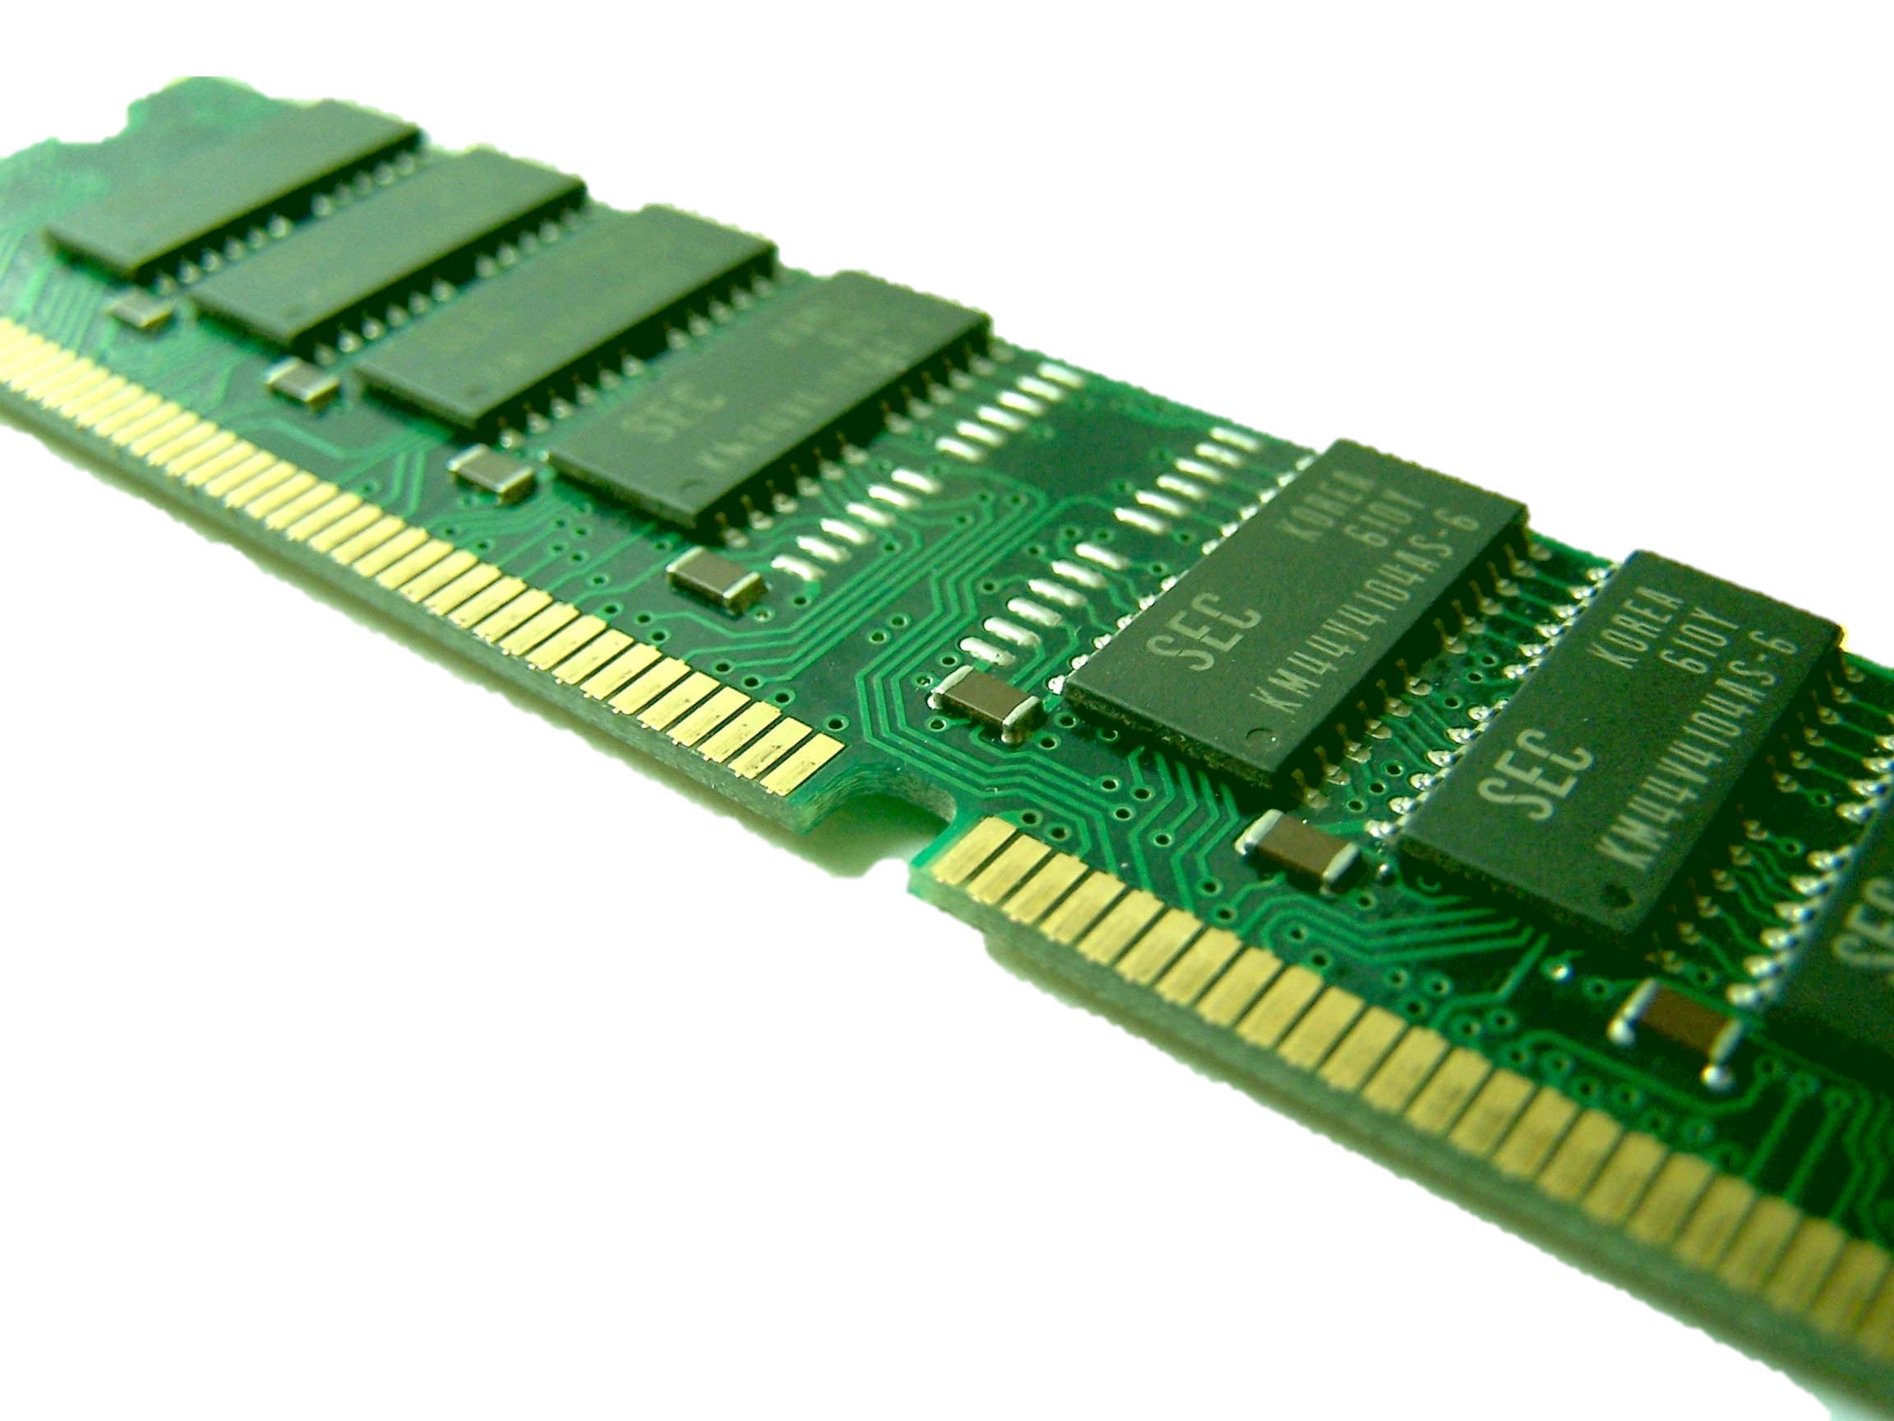
Process Scheduling
All programs are initially stored on a disk (Hard drive)
It has to move from a disk to memory
Then memory to the CPU
And the process can be reversed.

Slide 28
Process Scheduling
That is too easy….How??
Every process / job is in one of 5 states:
New
Ready
Running
Waiting
Terminated

Slide 29
Process scheduling
Every process / job is in one of 5 states:
1. New
Process wants to start
2. Ready
Process is loaded into memory and ready to start
3. Running
Process is currently being executed
4. Waiting
Process is waiting for something
5. Terminated
Process is finished

Slide 30
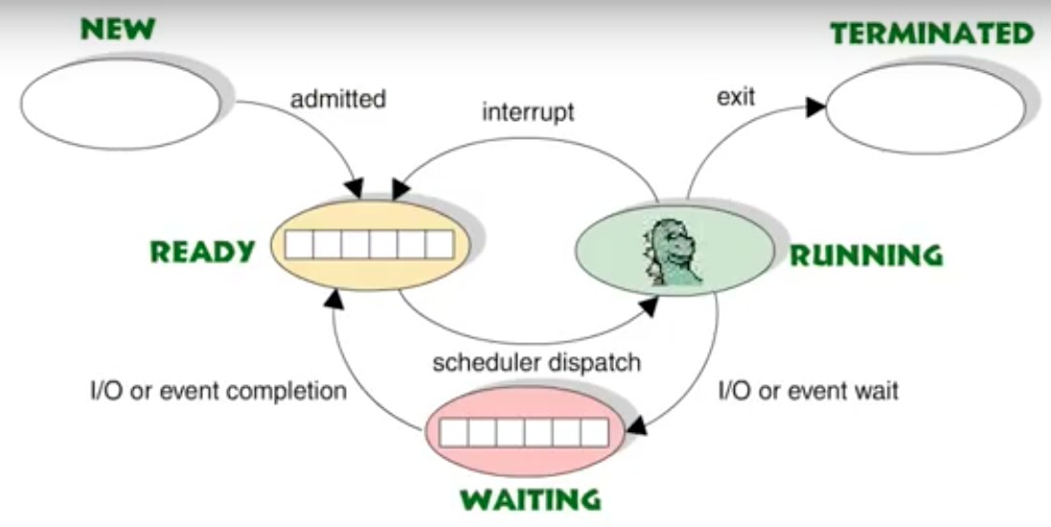
Process States

Slide 31
Interrupt
But sometimes a process is currently in a running state but then something happens – the process is interrupted.
Then whatever interrupted your program is dealt with.
Then once that interrupt is dealt with, your original tasks carries on.
But how does a computer know where to restart from?
This is managed by the ISR
ISR = Interrupt Service Routine
Notes:
How an interrupt is generated
How it is handled using an interrupt service routine
What happens as a result of the interrupts
Software interrupts include division by zero and two processes trying to access the same memory location
Hardware interrupts include pressing a key on the keyboard and moving the mouse

Slide 32
Interrupt Service Routine
The Interrupt Service Routine (ISR) is the name of some registers.
When your first task is running, it always has data in the ready block and the waiting block.
The ready block and waiting block are sometimes called the Process Control Block (PCB)
When an interrupt happens, the job of the ISR is to take the data in the PCB, save it and then tell the CPU to do the interrupt. Once the interrupt is finished, then the ISR puts the values back into the PCB so your first task can continue.

Slide 33
Quick note:
Confusing terms:
If an interrupt happens due to something relating to IO then it gets put in a waiting state.
If its not related to IO then it gets put back into a ready state – its not running, its just ready to be run.
The confusing bit is that sometimes this ready state is also called an idle state.
Cambridge: As far as they are concerned the above doesn’t happen. They say that every interrupt, based on IO or otherwise, puts the process in the waiting state.

Slide 34
What causes an interrupt?
Hardware interrupt
Pressing a key on keyboard (Escape, Enter…)
Pressing CTRL + ALT + DEL or Option + Command + Escape
Moving the mouse
Software interrupts
If two programs want to use the same memory location
If your program wants to divide by 0
Notes:
Software interrupts include division by zero and two processes trying to access the same memory location
Hardware interrupts include pressing a key on the keyboard and moving the mouse

Slide 35
Utility Tasks
We said that:
Utility tasks are things that make sure your hardware has no errors / not broken and is secure.
Disk formatter
Virus checker
Defragment
Disk content analysis / disk repair software
Backup software

Slide 36
1. Disk Formatter
Deletes everything from your hard drive.
+ When you sell your computer
+ If your OS has an error in it / want to install a different OS
Lose all your files
What it actually does it just makes every block on your hard drive 00000000 (or some other code that means empty) and then you put your new data on top of it.

Slide 37
2. Virus Checker
Guess what this does….
Checks your computer for viruses and other malware.
Used to be a separate program, but now built-in to most OS

Slide 38
3. Defragment
Remember we said you don’t know WHERE the actual binary of your file is stored on your hard drive.
Well your OS does. Now with Windows, it just puts it anywhere.
Now this is a problem because now I have one file in one place and a different file FAR FAR away from it.
These files are fragmented.
A defragmenter just puts your files near each other so the hard drive head does not have to travel far and your platter doesn’t have to spin as much.
Makes it faster to access your files

Slide 39
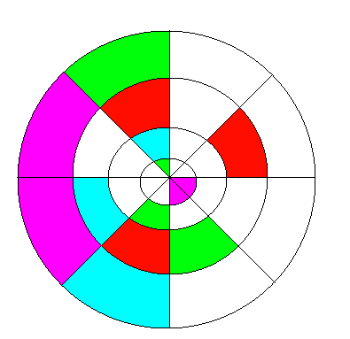
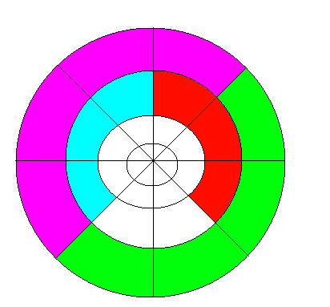
Defragment
Just moves your files closer together on the hard drive.
Left Image = Before defragment
Right Image = After defragment

Slide 40
4. Disk Contents Analysis / Disk Repair Software
This is where every track sector of your disk is checked to make sure it can read, write and store data correctly.
If it cannot then your OS has to perform a repair. Maybe its just deleting the data in that track sector, maybe its another repair, maybe you just have to format it.
Why we have it?
To make sure that all parts of our hard drive are working correctly.

Slide 41
5. File compression
Okay… we did a whole unit, 1.3, about compression.
Just taking a large file and reducing the size.
Either lossy or lossless
An OS usually compresses files in a .ZIP format
A .zip files works the same way as a Huffman tree.

Slide 42
6. Backup Software
Your OS also handles backups.
This next part covers data backup but also some other things that deal with data security.

Slide 43
Data xxxxxx
Data Security
Data Privacy
Data Integrity
Security = Making sure you keep your data secure. If something gets damaged or corrupted that you can recover the data
Privacy = Only the people you allow can see the data you allow them to see
Integrity = Data is up-to-date and accurate

Slide 44
Data Security
Keep data safe and make sure you can recover it if something bad happens.
What can happen?
Internal staff/students mess something up
Natural disasters
Hackers
Viruses

Slide 45
So what happens if something bad happens?
You want to make sure your data is secure.
You can do 4 main things to secure your data:
1: Data backup
2: Disk mirroring
3: Encryption
4: Authorisation
Your syllabus doesn’t care about any of these, but if I think we have time we will do these. (I put these slides in yellow)

Slide 46
Where is software?
All software is stored in your hard drive / SSD
This includes your Operating System and Application Software
To run your application software, you must first load your OS
So we can say that Application software is run on your OS
Stupid, stupid Cambridge.
Cambridge want me to say that:
“The operating system is run on the firmware”
“The bootloader (firmware) is run on the hardware”
Notes:
Applications are run on the operating system
The operating system is run on the firmware
The bootloader (firmware) is run on the hardware describe the role and operation of interrupts

Slide 47
Stupid Cambridge
“The operating system is run on the firmware”
“The bootloader (firmware) is run on the hardware”
When you first turn on your computer your computer loads your OS.
But how?
As soon as your CPU gets electricity for the first time, it doesn’t know to load the OS.
The only thing it knows is go to your ROM
Your ROM has does a few things. But the main thing it does is say “Load the OS”
The other instructions ROM has are:
Check hardware is okay
Check memory is okay
Check BIOS is okay
Load OS
Firmware = Name of the programs that are stored in ROM
Bootloader = The program in the firmware that says “Load the OS”

Slide 48
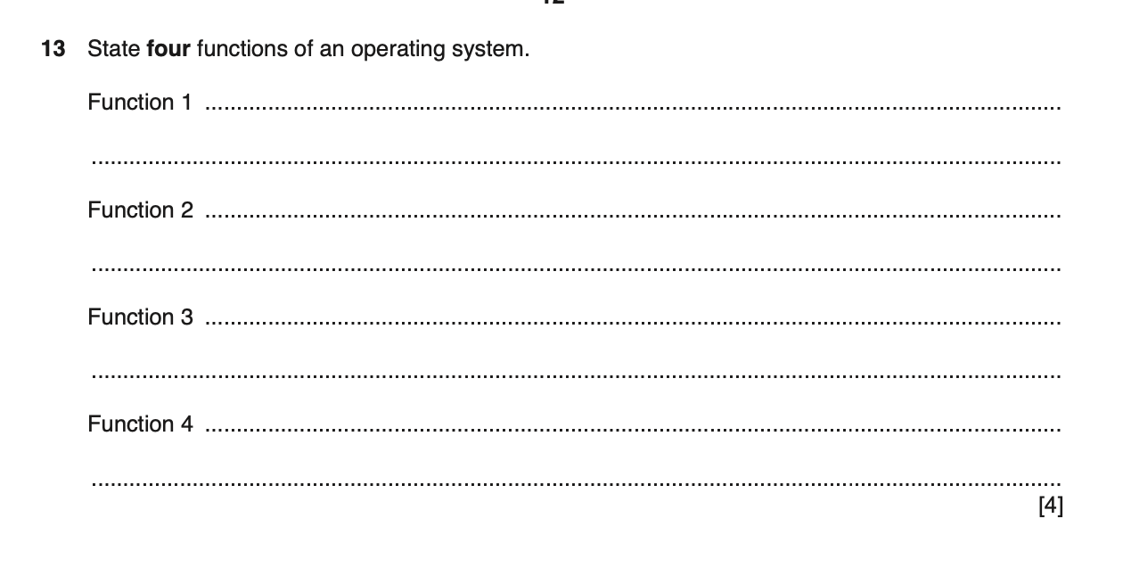
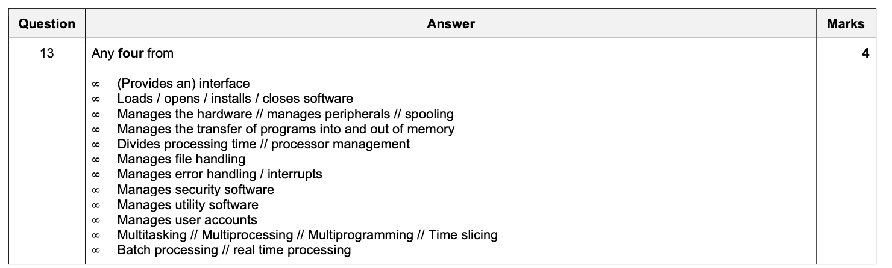

Slide 49
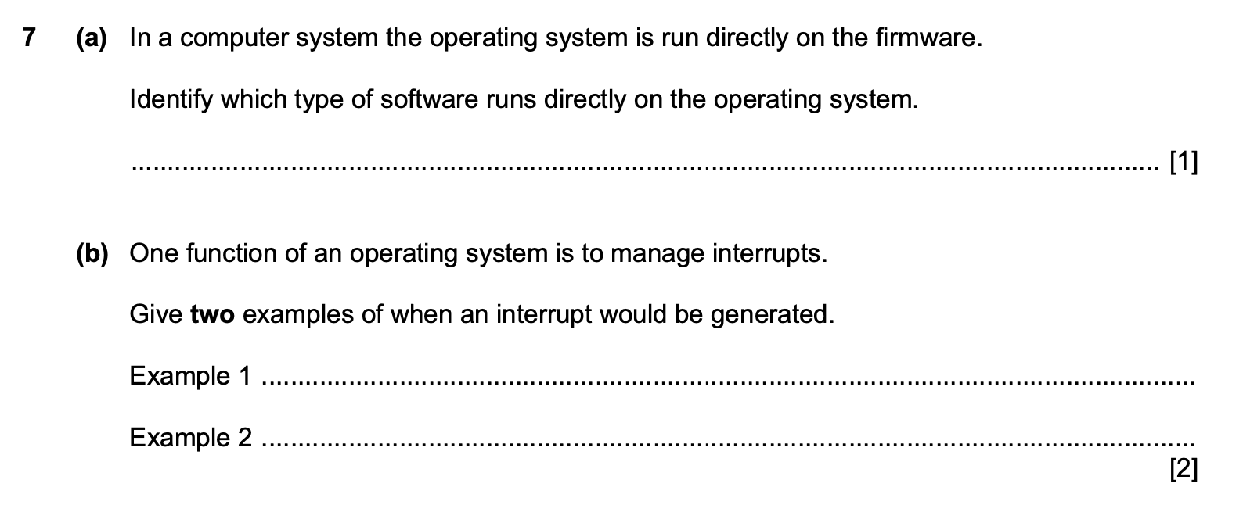
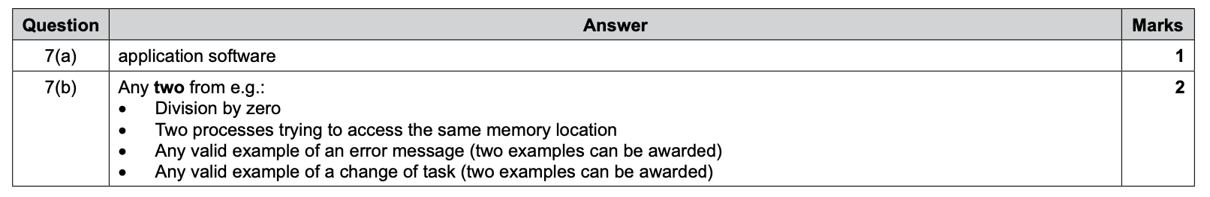

Slide 50
Data Backup
Save your data on your computer AND somewhere else
You need to think about a few things:
What to backup on (backup medium)
What you backup (full or incremental)
Where you store your backup
How often you backup?

Slide 51
Backup Medium
Medium | Advantages | Disadvantages
USB Flash Drive
External Hard Disk
CD / DVD
Tape Drive
Online

Slide 52
Full or Incremental?
Full backup = Everything
Incremental = Only things that have changed since your last backup

Slide 53
How often should you backup?
Balance between time, convenience, effort and fear of losing stuff.
Should:
Incremental – Daily
Full – Regular basis (weekly)
Keep two generations of backups at least.

Slide 54
Where
I backed up my files on my USB drive.
I do a incremental backup daily
I do a full backup weekly
I keep my USB in my pocket
Is it good?

Slide 55
Where
I backed up my files on a external hard drive
I do a incremental backup daily
I do a full backup weekly
I keep my external hard drive in my office and my laptop in my classroom
Is it good?

Slide 56
Summery
Data Backup
Save your data on your computer AND somewhere else
What to backup on (backup medium)
USB, Hard drive, CD, Online
What you backup (full or incremental)
Full = Everything. Incremental = Only things you changed since last backup
Where you store your backup
Offsite
How often you backup?
Daily, Weekly, Monthly..

Slide 57
Disk Mirroring
Data backup is when you save your data – but YOU have to remember to backup and YOU have to remember when and YOU have to remember what to backup.
Disk Mirroring is when data on your hard drive is copied onto another drive.
Its automatic and simultaneous
Commonly called RAID
Redundant Array of Inexpensive / Independent Disks
There are many types of RAID

Slide 58
Video
What does RAID stand for?
Is there RAID 4?
Does RAID 0 have redundancy?
Does RAID 1 use striping?
Which RAID version uses parity?
What is RAID 1+0 usually called?
Can you join different RAIDs together?
Describe RAID 0 to the class
Describe RAID 1 to the class
Describe RAID 5 to the class

Slide 59

Video

Slide 60
Video
What does RAID stand for?
Is there RAID 4?
Does RAID 0 have redundancy?
Does RAID 1 use striping?
Which RAID version uses parity?
What is RAID 1+0 usually called?
Can you join different RAIDs together?
Describe RAID 0 to the class
Describe RAID 1 to the class
Describe RAID 5 to the class

Slide 61
Today
4. Show understanding of program libraries
7. software under development is often constructed using existing code from program libraries
8. the benefits to the developer of software constructed using library files, including Dynamic Link Library (DLL) files
Understand: What are program libraries
Able: Explain DLL’s
Answer: What are the advantages of using program libraries?

Slide 62
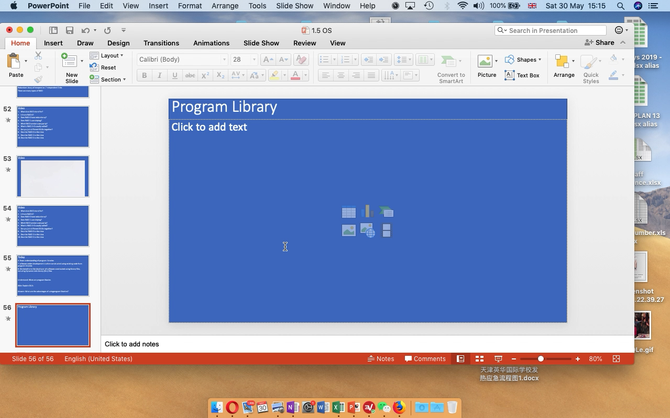
Program Library

Slide 63
Program libraries
How can MIRCOSOFT have the same print box as APPLE print box as OPERA’s (if I select it)
They use program libraries.
A program library is just code written by the people who made your OS.
So when you are making your own program and you want to have a save feature, or print, or new….. Instead of making your own, you can use the one that the OS developer has already made.
+Saves your time, you don’t have to make anything new
+Saves money, because you are not wasting your time
+Guaranteed to work, because they (the OS people) made it
+Familiar layout to the users
-Not customized to your needs
-If the library file gets corrupted then you have big problems

Slide 64
LIB vs DLL
Well, there are two ways you can make your program.
Static Linked Library (LIB)
Dynamic Linked Library (DLL)

Slide 65
Static Linked Library
A static linked library – LIB file, is when:
Let’s say you are making your program and you want a Print feature.
With a static link library, you:
Write your code
Make a link to the Print feature from the program library
No problem.
Now, when you run the the code and it gets to the Print feature, it does not LINK to the print feature, it COPIES it into your final .exe code
You are still using a program library because you did not have to write the Print feature, but now your final code is bigger because it COPIED the Print feature into your code.

Slide 66
Dynamic Link Library
Let’s say you are making your program and you want a Print feature.
With a dynamic link library, you:
Write your code
Make a link to the Print feature from the program library
No problem.
Now, when you run the the code and it gets to the Print feature, it LINKS to the print feature, no coping needed.
This means your file size is smaller
Annoying time:
Is a DLL a library that holds print, new, save open?
Or
Is it the name of the file used to LINK to a program library
Both. You get DLL which is an actual library and a DLL file which links to the DLL library

Slide 67
LIB vs DLL
So why not just use DLL for everything?
Many people do, only problem is if the DLL file gets corrupted then you have big problems.
Also using DLL is a good way to infect a PC with malware.
But it is smaller and when the OS gets updated, your program which links to the DLL also will get the new features of Print, save, open…….

